Slide 1

Predicting Uber Fares: A Machine Learning Approach
Uber

Slide 2

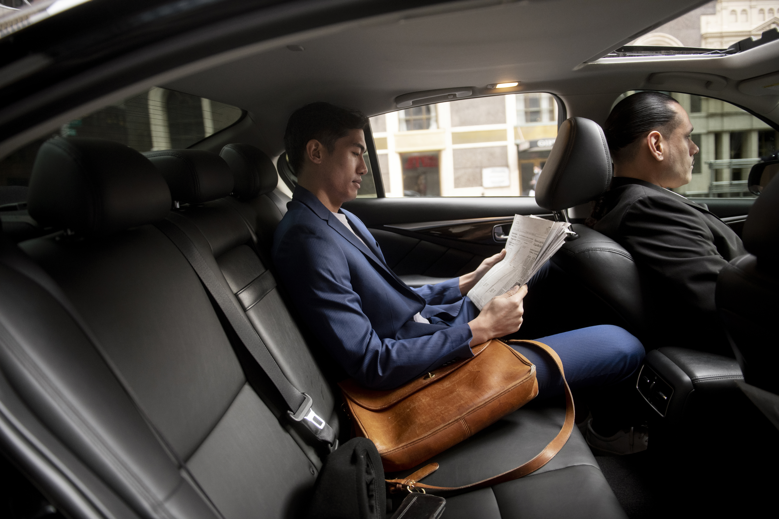
Project Objectives:
Identify key factors influencing Uber fare prices
Develop and compare various regression models
Evaluate model performance for real-world applications

Slide 3

From Raw Data to Insights.
Dataset:
200,000 Uber rides in New York City
Features: pickup/dropoff coordinates, datetime, passenger count, fare
Preprocessing Steps:
Removed outliers and erroneous data (5.2% of original data)
Feature engineering: trip distance, temporal features
Final dataset: 189,600 clean ride records
Key Challenges:
Handling geospatial data
Addressing outliers in fares and distances
Notes:
Data Overview and Preprocessing

Slide 4
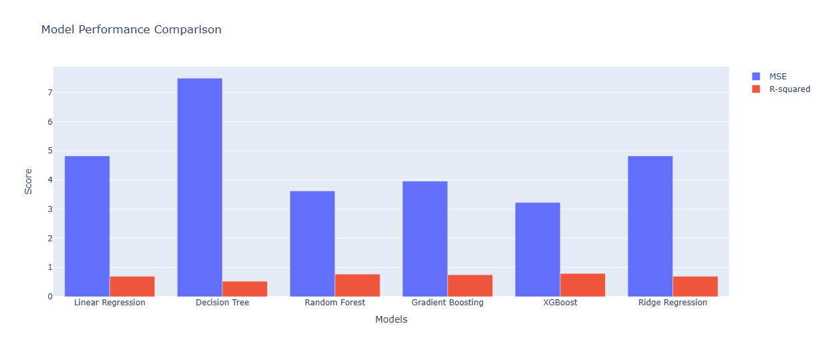
Predictive Models: Performance Overview
Model Performance (MSE, R-squared):
XGBoost: 3.23, 0.80
Neural Network: 3.41
Random Forest: 3.62, 0.77
Gradient Boosting: 3.96, 0.75
Linear/Ridge Regression: 4.82, 0.70
Decision Tree: 7.49, 0.53
Key Findings:
Non-linear models outperformed linear models
XGBoost showed the best predictive power
Notes:
Model Comparison and Results

Slide 5
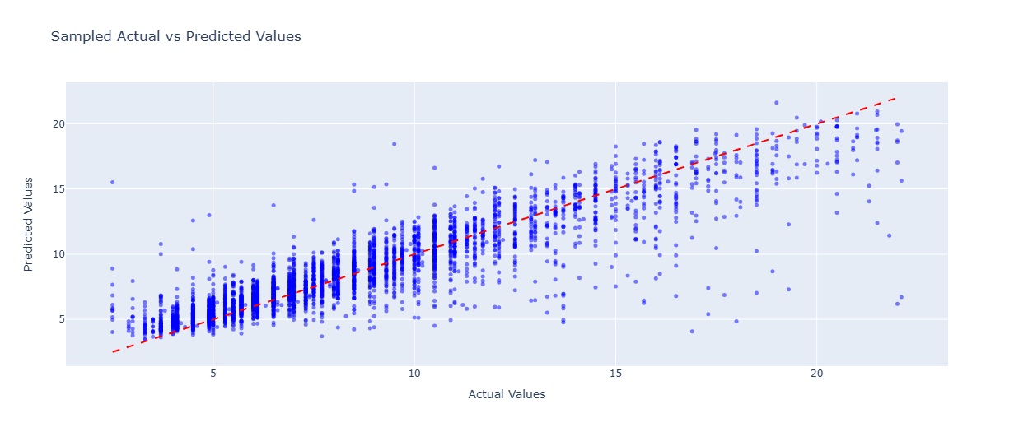
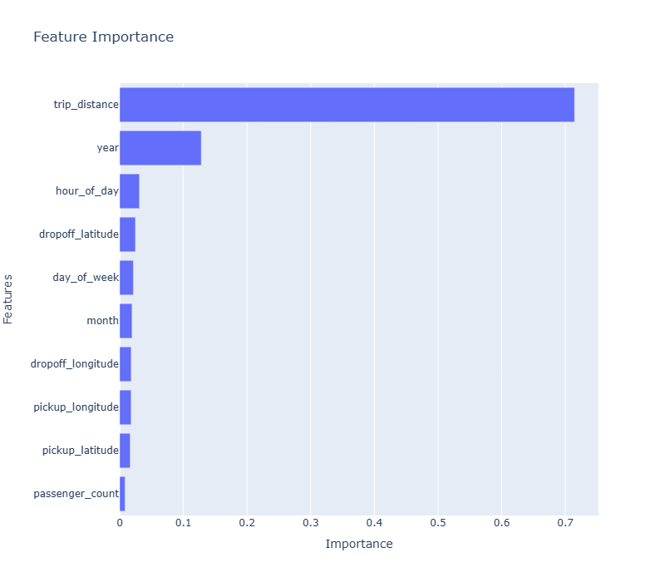
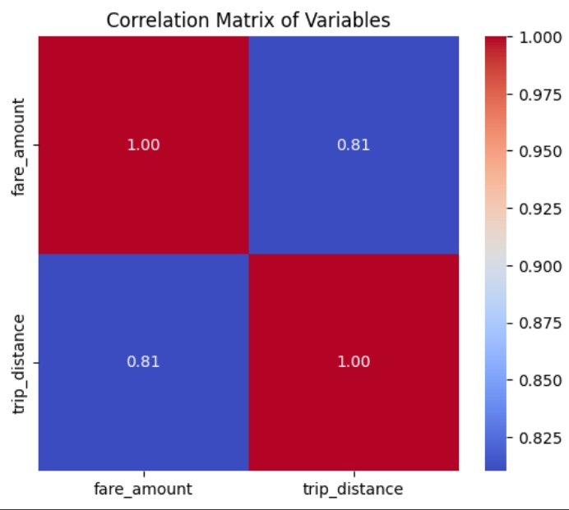
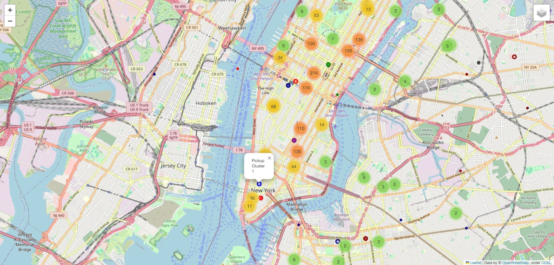
Notes:
Exploratory Data Analysis Highlights

Slide 6

Insights and Next Steps
Conclusions:
XGBoost is most effective for fare prediction
Spatial and temporal features are crucial
Future Work:
Incorporate external factors (weather, events)
Explore advanced techniques (deep learning)
Impact:
Potential for more accurate pricing models
Enhanced user experience in ride-sharing services

